Slide 1
3 BIT/PIXEL encoding with various Noises and Dataset
We tried encoding 3 bits/pixel of image data for MNIST,CIFAR10,CELEBA.
Since we are training encoder, decoder and discriminator together in one forward pass, we find that at backtracking loss multiple times through decoder and encoder for same forward pass increases efficiency. We fix this multiplier as 5 for encoder and decoder and 1 for discriminator. (5:5:1)
Different types of channel noises explored are – Salt and pepper, random data cropping, AWGN noise
Inference is that by increasing the level of randomness in image, we improve encodability. Consistently seen across dataset. So if you have a prior on what type of noise you will encounter in channel, you can get better encoding power.
-Saket Mangalam

Slide 2
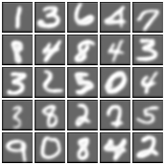
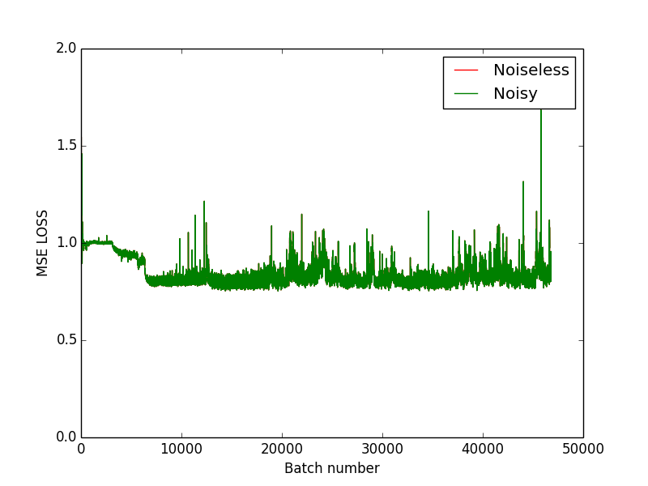
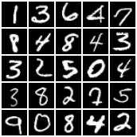
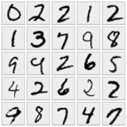
NO PRIOR on NOISE (benchmark encoding)
MNIST
No change in encoding Encoded Real encoder diff

Slide 3
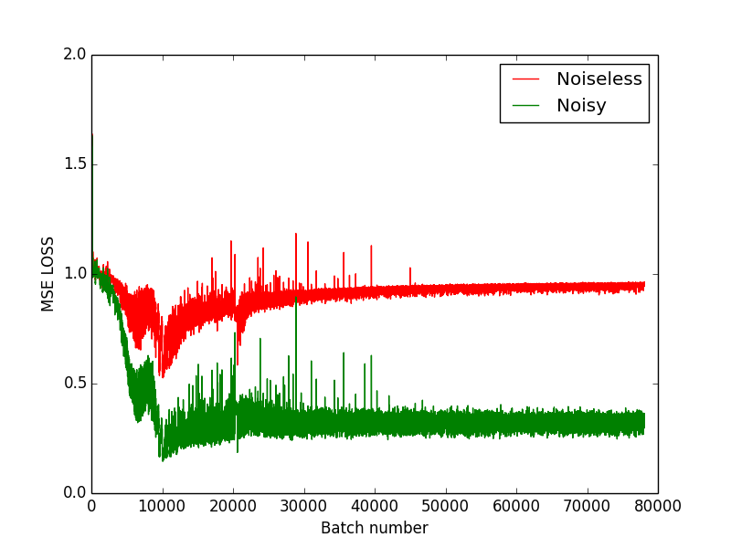
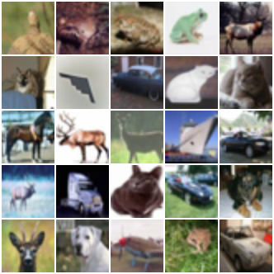

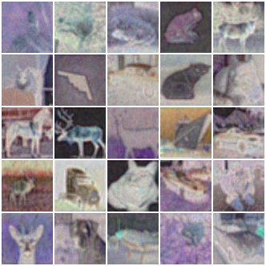
NO PRIOR on NOISE (benchmark encoding)
CIFAR10
Mseloss encoded real encoder diff

Slide 4
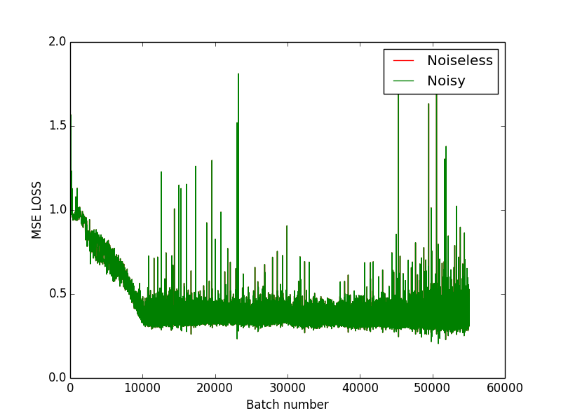
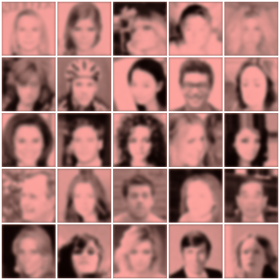
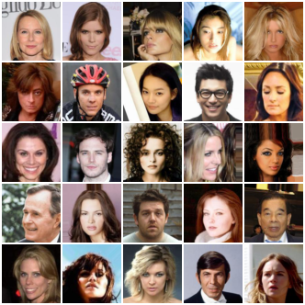
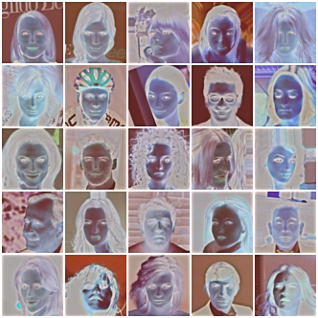
NO PRIOR on NOISE (benchmark encoding)
CELEBA
MSELOSS encoded real encoder diff

Slide 5
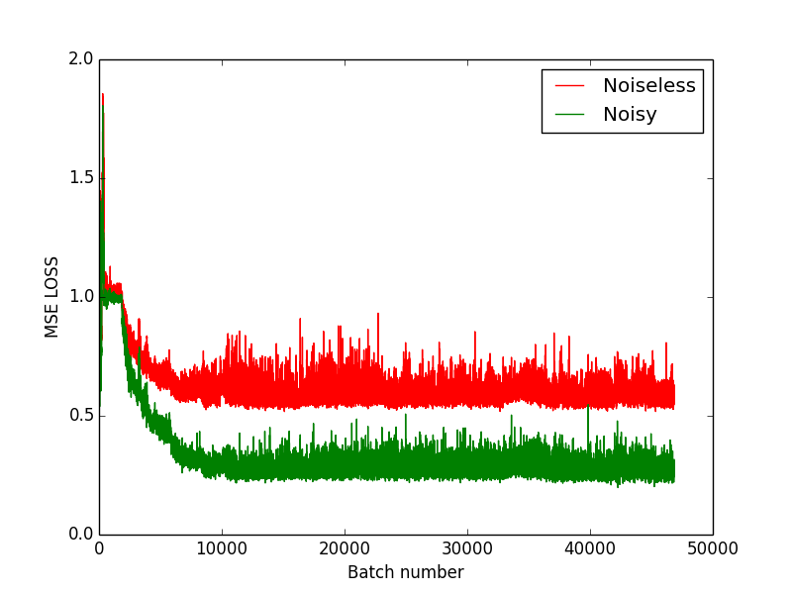
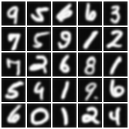
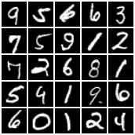
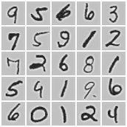
AWGN NOISE (till standard deviation of 0.1)
MNIST
MSELOSS encoded real encoder diff

Slide 6
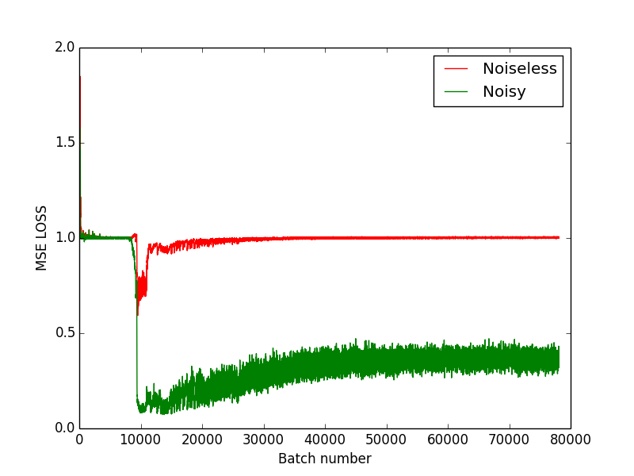

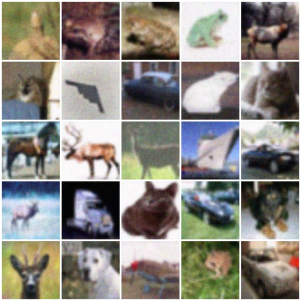
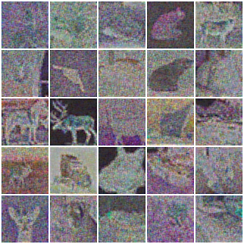
AWGN NOISE (till standard deviation of 0.3)
CIFAR10
MSELOSS encoded real encoder diff

Slide 7
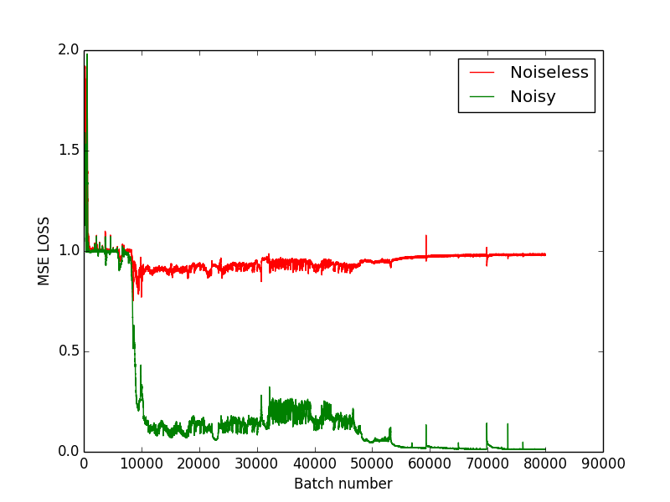
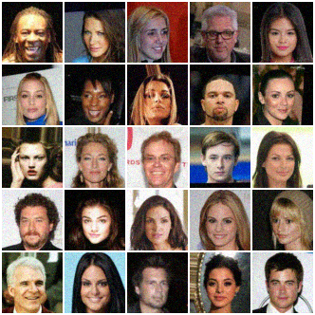
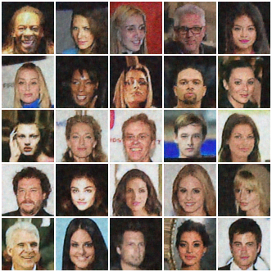
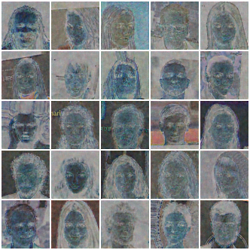
AWGN NOISE (till standard deviation of 0.3)
CELEBA
MSELOSS encoded real encoder diff

Slide 8
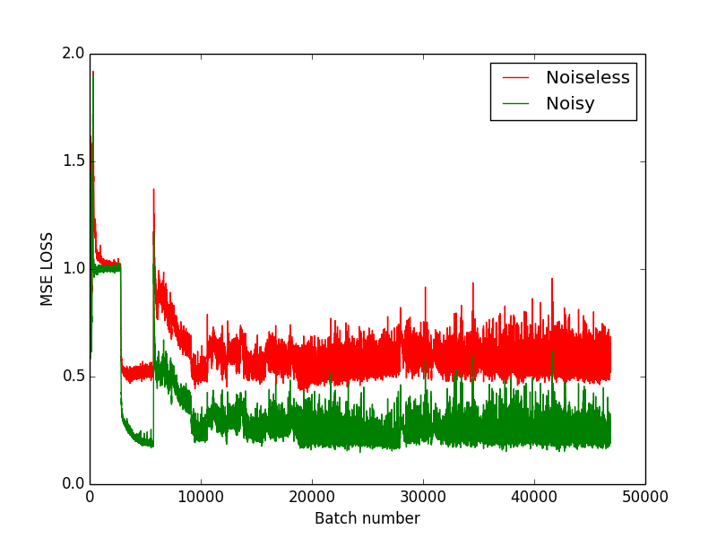
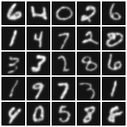
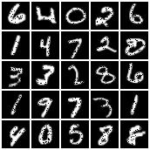
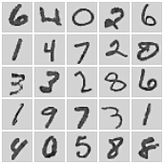
SALT&PEPPER NOISE (20% pixels are 0)
MNIST
MSELOSS Encoded Real encoder diff

Slide 9
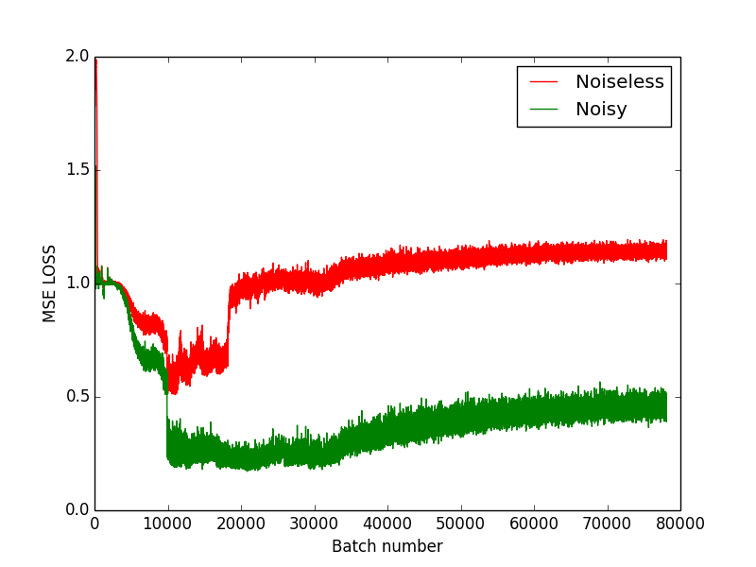
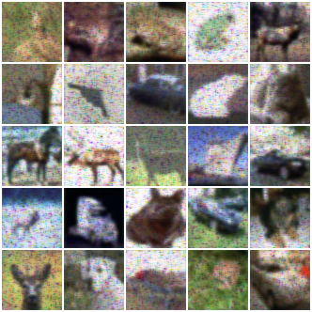
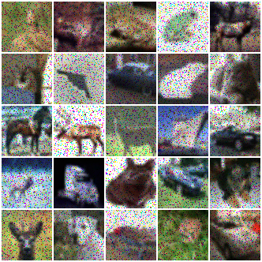
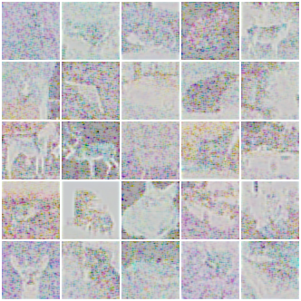
SALT&PEPPER NOISE (20% pixels are 0)
CIFAR10
MSELOSS Encoded Real encoder diff

Slide 10
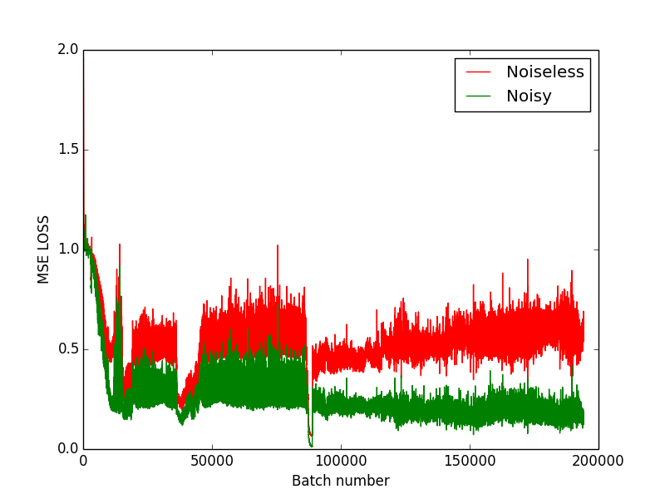
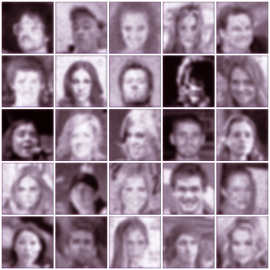
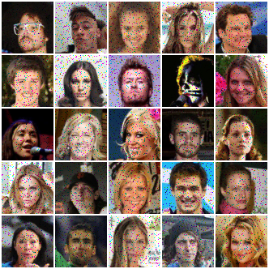
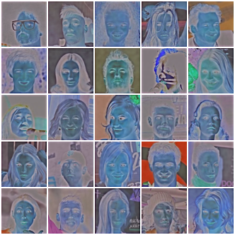
SALT&PEPPER NOISE (20% pixels are 0)
CELEBA
MSELOSS Encoded Real encoder diff

Slide 11
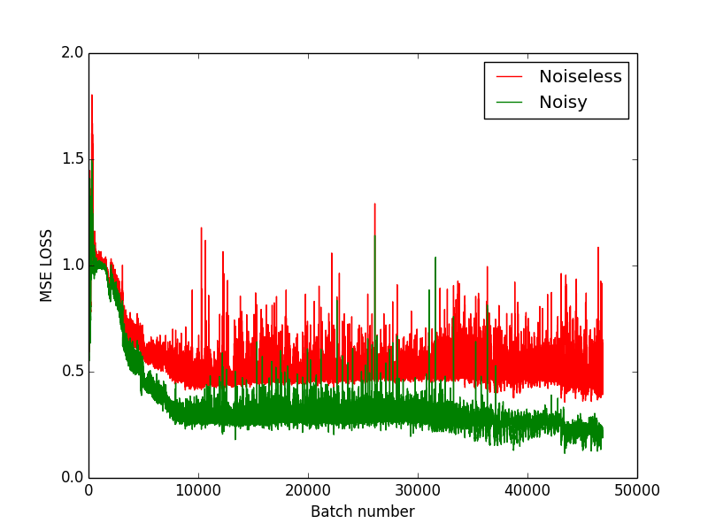
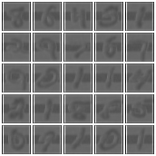
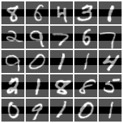
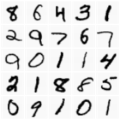
SLIDING WINDOW NOISE (10*width pixels are 0)
MNIST
MSELOSS Encoded Real encoder diff

Slide 12
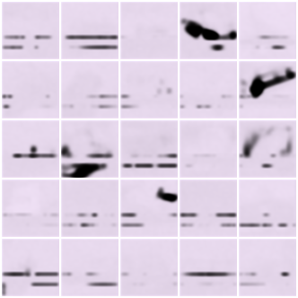
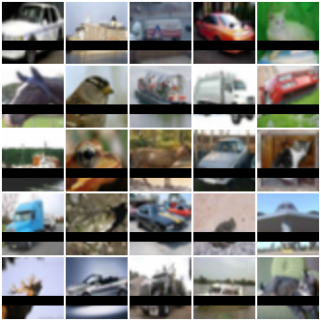
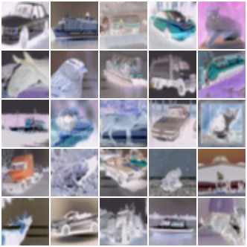
SLIDING WINDOW NOISE (10 *width pixels are 0)
CIFAR10
MSELOSS Encoded Real encoder diff

Slide 13
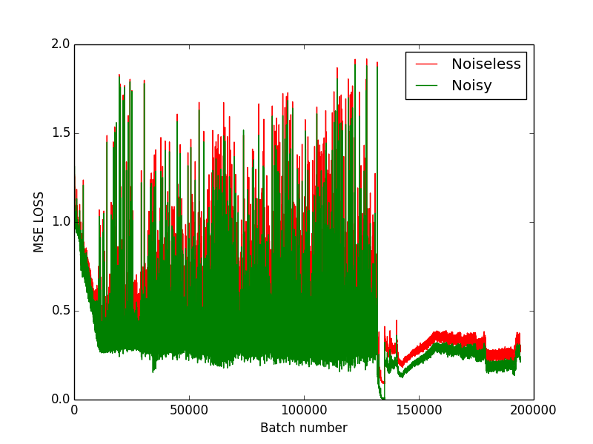
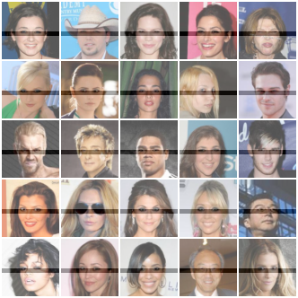
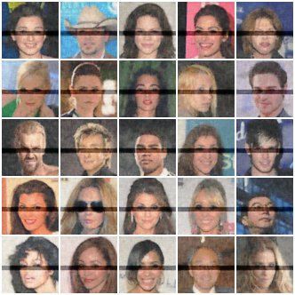
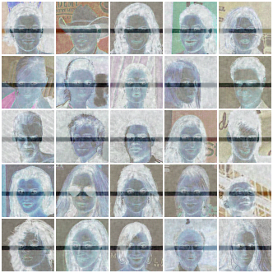
SLIDING WINDOW NOISE (10 *width pixels are 0)
CELEBA
MSELOSS Encoded Real encoder diff

